Slide 1
Freedom of Expression and Loving Your Neighbor
Diversity & Inclusion Small Steps. Calvin University
Notes:
Welcome to “Freedom of Expression and Loving Your Neighbor”
a segment in the Diversity & Inclusion Small Steps
at Calvin University.

Slide 2
D&I Small Steps
If you have time for a cup of coffee, then you have time for …
Information, Tools, and Strategies to help understand racism, value diversity, and create inclusive communities.
Notes:
Diversity & Inclusion Small Steps
offer short learning opportunities that provide information, tools, and strategies to help understand racism, value diversity, and create inclusive communities.

Slide 3
Freedom of Expression and Loving Your Neighbor
Notes:
In this segment we are highlighting university policies related to freedom of expression and offering some concrete strategies for shaping our learning spaces in polarized times. The hope is to create some awareness and perhaps open spaces for constructive discussion about how to navigate through our divisive and polarized times as a community.

Slide 4
Notes:
Freedom of Expression or Freedom of Speech seems built into the DNA of the United States. In Summer 2020, we experienced as a country many protests as a part of the national crisis of conscience related to #blacklivesmatter and racial injustices in our country.

Slide 5
Notes:
Although there are perhaps fewer Protests and rallies associated with the 2020 election season because of the COVID health crisis, it is easy to find examples of people exercising their freedom of expression – sometimes in ways that others find disrespectful, akin to harassment, or even dangerous.

Slide 6
Notes:
Indeed sometimes it feels like everything can be made racial and everything can be interpreted as political.

Slide 7
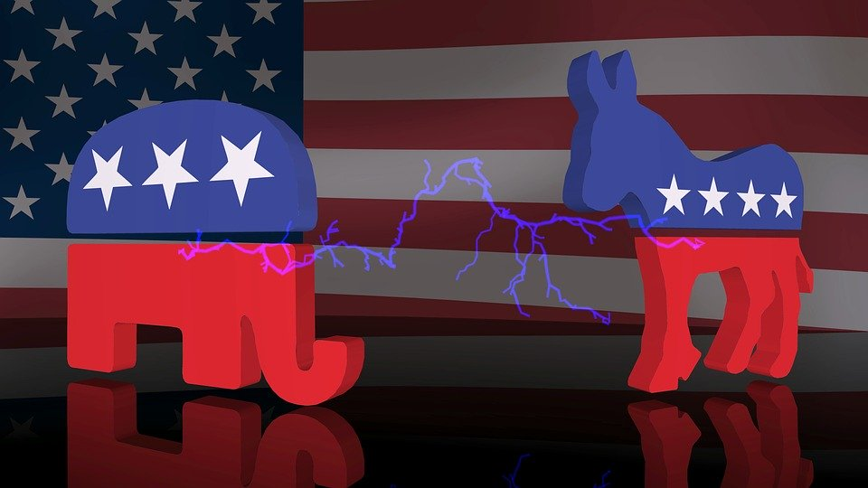
https://www.youtube.com/watch?v=ZzpE3GXoguE
Notes:
Over recent years the political climate in the US has become polarized to a greater extent than in the past. Nowadays our political leanings tend to become part of our ideas of group membership, part of our identity in ways that connect emotions and cultures, faith and our sense of who belongs and who doesn’t. This polarization is morphing into tribalization which tends to makdisable us from engaging constructively across our lines of difference.

Slide 8
https://www.youtube.com/watch?v=ZzpE3GXoguE
Notes:
Political Scientist Kevin den Dulk offers a great 8-minute introduction to Political Division and the Challenge of Civil Society,
in the video linked here. He discusses affective polarization and explains how this plagues our current climate and actually fosters intolerance.

Slide 9
Notes:
Especially though not exclusively during an election season, the polarization and tribalization in our society shape our learning spaces. The emotions and identity-related-ness of our politics can make it challenging to engage respectfully, to feel safe, to focus on the course content. And what’s happening in current events, including at the polling stations can affect our students at a deep emotional level and thus shape our learning spaces.

Slide 10
Freedom of Expression
Notes:
At Calvin, we believe that the free exchange and expression of ideas flows from our Christian mission and contributes to the flourishing of our educational community and the health of our pluralistic society. We believe that the free exchange of ideas carries tremendous responsibility. We need to engage outside our echo chambers with respect for those who think differently from us. Our mutual understanding grows when we listen to one another well and leave with deeper understanding of the issues and of each other – even if our positions don’t change.

Slide 11
Freedom of Expression
University Statement and FAQ
https://calvin.edu/directory/policies/freedom-of-expression-at-calvin-university
Notes:
Calvin has published a statement on Freedom of Expression at Calvin University.
Approved by the University Board of Trustees in October of 2019, this statement includes responses to Frequently Asked Questions and links to other relevant documents such as:
a “Confessional Commitment and Academic Freedom” document,
the “From Every Nation” document,
the “Safer Spaces” Policy,
the “Residence Hall Reference Guide”, and
Calvin’s Policy on Manner and Method of Dissent, also known as the “protest policy”.

Slide 12
Freedom of Expression
Calvin University intentionally avoids partisan alignment.
Calvin reserves the right to limit freedom of speech or expression when the intention is to harm individuals or groups of people or when it creates a hostile, unsafe environment.
We should as a community and as individuals consider both the intent and the impact of what we do and say, of how we exercise our freedoms, including the freedom of expression.
Notes:
Important take-aways from Calvin’s Freedom of Expression statement include the following:
Calvin University intentionally avoids partisan alignment.
Calvin reserves the right to limit freedom of speech or expression when the intention is to harm individuals or groups of people or when it creates a hostile, unsafe environment.
We should as a community and as individuals consider both the intent and the impact of what we do and say, of how we exercise our freedoms, including the freedom of expression.

Slide 13
Brave Spaces
Encourage
Encourage dialogue
Enable
Enable open discussion of sometimes opposing ideas with civility
Include
Include recognition of intentions and impacts
Allow
Allow participants to step in and out while encouraging reflective engagement
Embody
Embody respect and avoid attacks or harassment of others
Notes:
In our Freedom of Expression document, we also describe Brave Spaces – the type of spaces we want to create both inside and outside the classroom.
Brave Spaces are characterized by the following.
Brave Spaces encourage dialogue.
They enable open discussion sometimes opposing ideas with civility.
Brave Spaces include recognition of intentions and impacts.
They allow participants to step in and out while encouraging reflective engagement and not dis-engaging.
And Brave Spaces embody respect. In Brave Spaces we avoid attacking or harassment of others.

Slide 14
Learning spaces
brave - safe – focused on learning
Notes:
Our learning spaces now and always
should be Brave Spaces where people feel safe and are enabled to focus on learning.

Slide 15
Good to know
University Policies
Students may hang political posters in their dorm rooms but not in their windows.
Students may wear clothing items with political slogans on them.
If a student feels harassed, unsafe, or discriminated against, they can consider if a report to SaferSpaces is appropriate.
Campus Leaders for addressing freedom of expressions issues include:
Provost
Vice President for Student Life
Director of Human Resources
Notes:
Here are some Good to know University Policies.
Students may hang political posters in their dorm rooms but not in their windows.
Students may wear clothing items with political slogans on them.
If a student feels harassed, unsafe, or discriminated against, they can consider if a report to SaferSpaces is appropriate.
Campus Leaders for addressing freedom of expressions issues include:
Provost
Vice President for Student Life
Director of Human Resources

Slide 16
Strategy
Engage students in creating a classroom atmosphere that is brave, safe, and focused on learning.
Can you recruit students to limit the distractions of a polarized and tribalized political season to appropriate venues and spaces?
Can you establish community ground rules for creating brave spaces, that emphasize charitable listening to learn?
Can you help students understand the (distracting) impact of certain slogans or political banter. [Intent and Impact]
Notes:
I’m going to conclude this Small Steps segment with three concrete strategies.
Engage students in creating a classroom atmosphere that is brave, safe, and focused on learning.
Can you recruit students to limit the distractions of a polarized and tribalized political season to appropriate venues and spaces?
Can you establish community ground rules for creating brave spaces, that emphasize charitable listening to learn?
Can you help students understand the (distracting) impact of certain slogans or political banter. [Intent and Impact]

Slide 17
Strategy
Acknowledge the elephant in the room
Whatever the results of the 2020 election or the next political debate or the newest hot-button issue, people will be on different sides. Recruit students in advance to commit to showing respect for others’ opinions and feelings.
Have students create a list of behaviors or community expectations that will enable your classroom to be an inclusive learning space for all learners. Do this in advance to enable the learning you are hoping for … on the day after the election.
Can you create ground rules and then a mechanism for persons to react to current events OR can you winsomely explain how and where this can be done with guidance toward constructive ends.
Notes:
Acknowledge the elephant in the room
Whatever the results of the 2020 election or the next political debate or the newest hot-button issue, people will be on different sides. Recruit students in advance to commit to showing respect for others’ opinions and feelings.
Have students create a list of behaviors or community expectations that will enable your classroom to be an inclusive learning space for all learners. Do this in advance to enable the learning you are hoping for … on the day after the election.
Can you create ground rules and then a mechanism for persons to react to current events OR can you winsomely explain how and where this can be done with guidance toward constructive ends.
Especially in virtual spaces it is difficult to “read the room.” So, we need to remind students to be aware and sensitive to the learning states of others and to channel their own emotions or potentially distracting comments or issues in constructive ways inside our virtual classes as well.

Slide 18
Strategy
Build your capacity to navigate sticky situations and help your students do the same.
Participate in further learning opportunities.
Do you feel called to integrate discussion of politics or freedom of expression into your course? If so, can you increase your skill set to facilitate difficult conversations?
Be aware of appropriate venues to process current events, opportunities for learning, and support services and persons.
Notes:
Build your capacity to navigate sticky situations and help your students do the same.
Participate in further learning opportunities.
Do you feel called to integrate discussion of politics or freedom of expression into your course? If so, can you increase your skill set to facilitate difficult conversations?
Be aware of appropriate venues to process current events, opportunities for learning, and support services and persons.

Slide 19
Loving Your Neighbor
Notes:
In short, in a time when polarization and tribalization characterize our country, we as educators want to remind, encourage, and enable our students to embody Love of Neighbor – even when and perhaps especially when it’s hard to do.

Slide 20
Diversity & Inclusion Small Steps
Freedom of Expression and Loving Your Neighbor
Pennylyn Dykstra-Pruim
associate dean for diversity & inclusion
Calvin University

